Slide 1

US Population Shifts 2010-2017
Eli Lobato
Brandon Cawthorne
Jason Peters

Slide 2
Motivation & Summary
Hypothesis
People are moving to the south west US and one of the factors is cost of living.
Questions
1) What are the top 5 cities in the US people are moving to/from?
Summary of Findings
Based on the data collected, we are able to determine people are moving south west. Because there are too many factors that could be contributing to the population shift, we decided to focus on housing costs and average household income. Based on those factors, the only correlation that can be confirmed is housing costs.
2) What regions of the US people are moving to/from?
3) What are some of the factors contributing to the population shift?
Overview
Questions and Data
Data Cleanup/Exploration
Data Analysis Q1
Data Analysis Q2
Data Analysis Q3
Summary

Slide 3
Questions & Data
What are the top cities in the US people are moving to/from?
What regions of the US people are moving to/from?
What are some of the factors contributing to the population shift?
To answer these questions, we decided to use population data from the census website as our core data set. Once we collected the population data, we called the google API to generate the latitude and longitude of the top cities people are moving to/from to create a heatmap. We then collected average household income data from the census website and average housing costs from Zillow to analyze some of the contributing factors. From there we were able to start cleaning and exploring the data.
Overview
Questions and Data
Data Cleanup/Exploration
Data Analysis Q1
Data Analysis Q2
Data Analysis Q3
Summary

Slide 4
Data Cleanup & Exploration
Decided to use only cities with 100k population and up.
Found the average growth of each city year over year.
Selected the top 5 cities people are moving to/from.
Merged census population file with census average household income to create a single csv.
Called Google API for lat/lon.
Used Zillow data set to analyze housing costs.
Overview
Questions and Data
Data Cleanup/Exploration
Data Analysis Q1
Data Analysis Q2
Data Analysis Q3
Summary

Slide 5
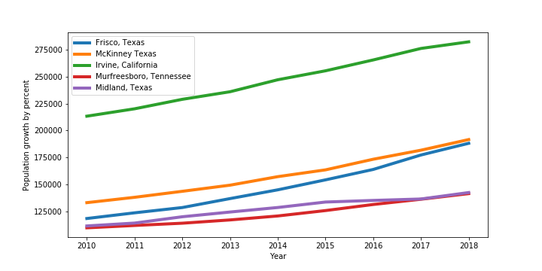
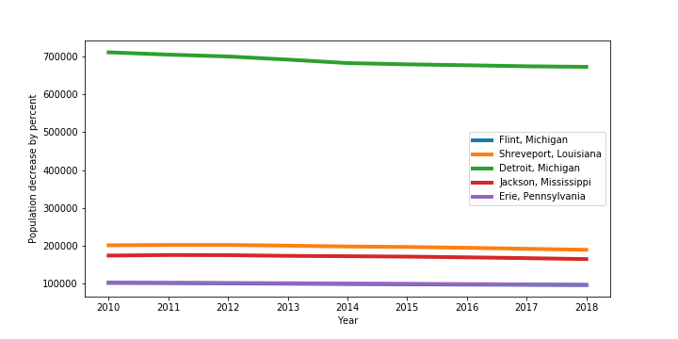
Data Analysis and Discussion Q1
Overview
Questions and Data
Data Cleanup/Exploration
Data Analysis Q1
Data Analysis Q2
Data Analysis Q3
Summary

Slide 6
Data Analysis and Discussion Q2
Overview
Questions and Data
Data Cleanup/Exploration
Data Analysis Q1
Data Analysis Q2
Data Analysis Q3
Summary

Slide 7
Data Analysis and Discussion Q2
r-squared = 0.206
r-squared = -0.117
Overview
Questions and Data
Data Cleanup/Exploration
Data Analysis Q1
Data Analysis Q2
Data Analysis Q3
Summary

Slide 8
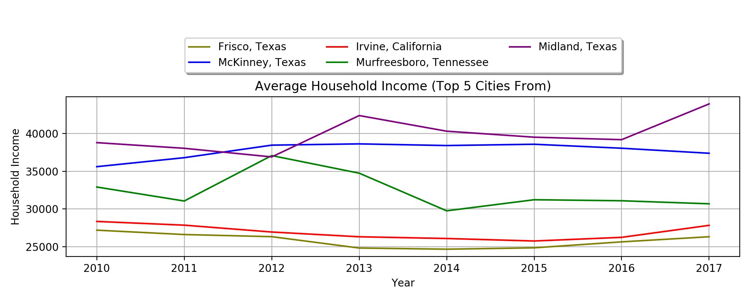
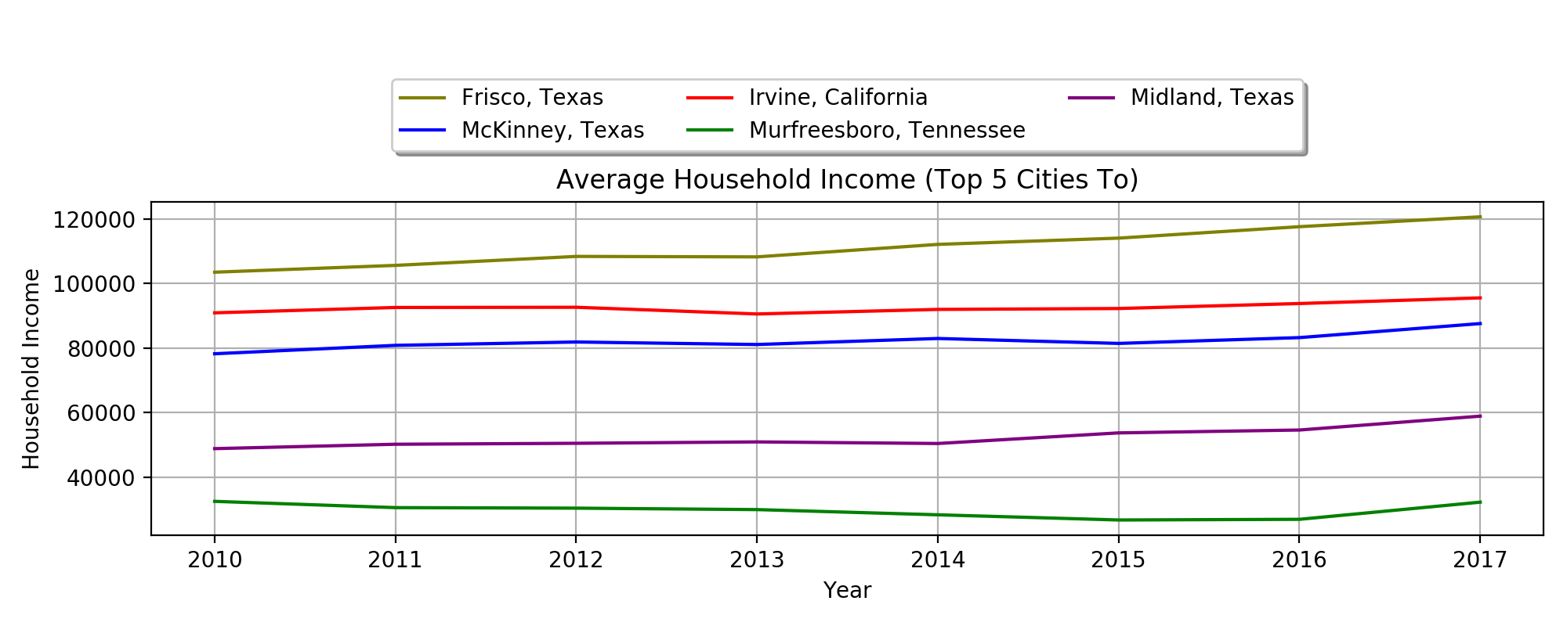
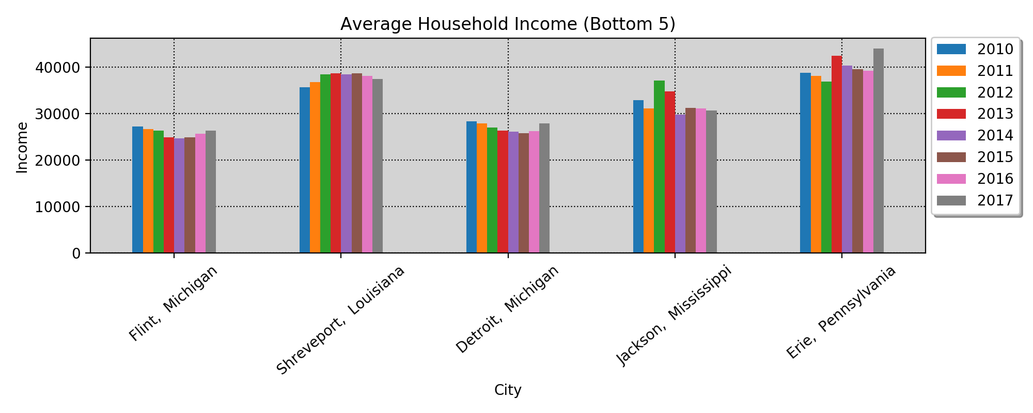
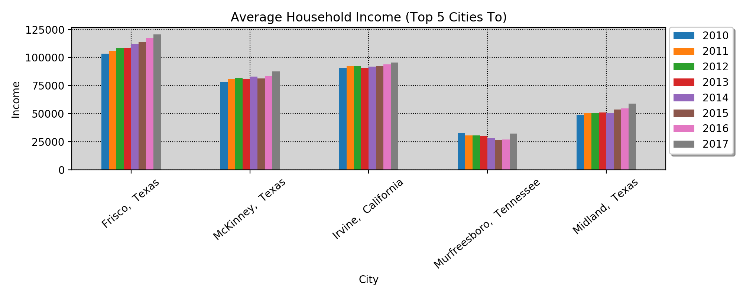
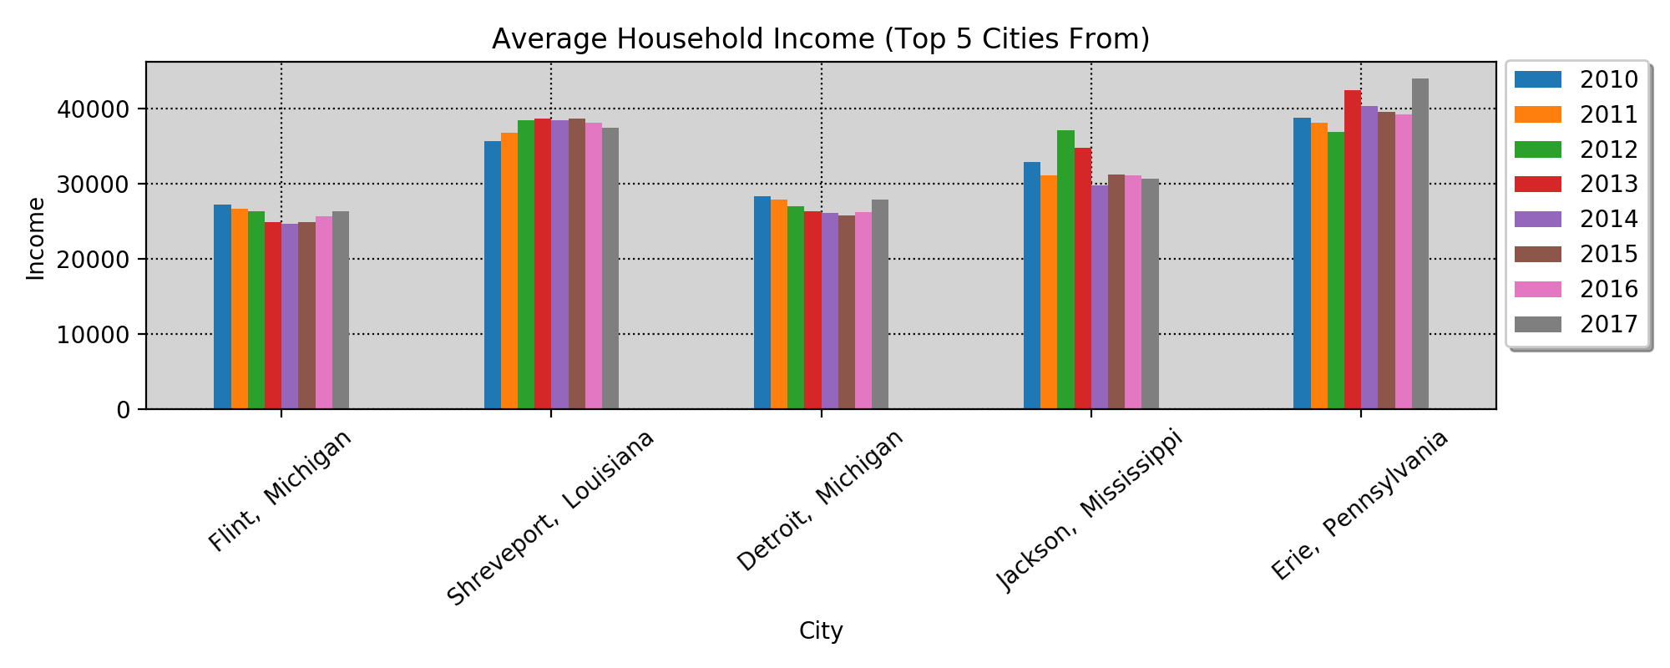
Data Analysis and Discussion Q3
Overview
Questions and Data
Data Cleanup/Exploration
Data Analysis Q1
Data Analysis Q2
Data Analysis Q3
Summary

Slide 9
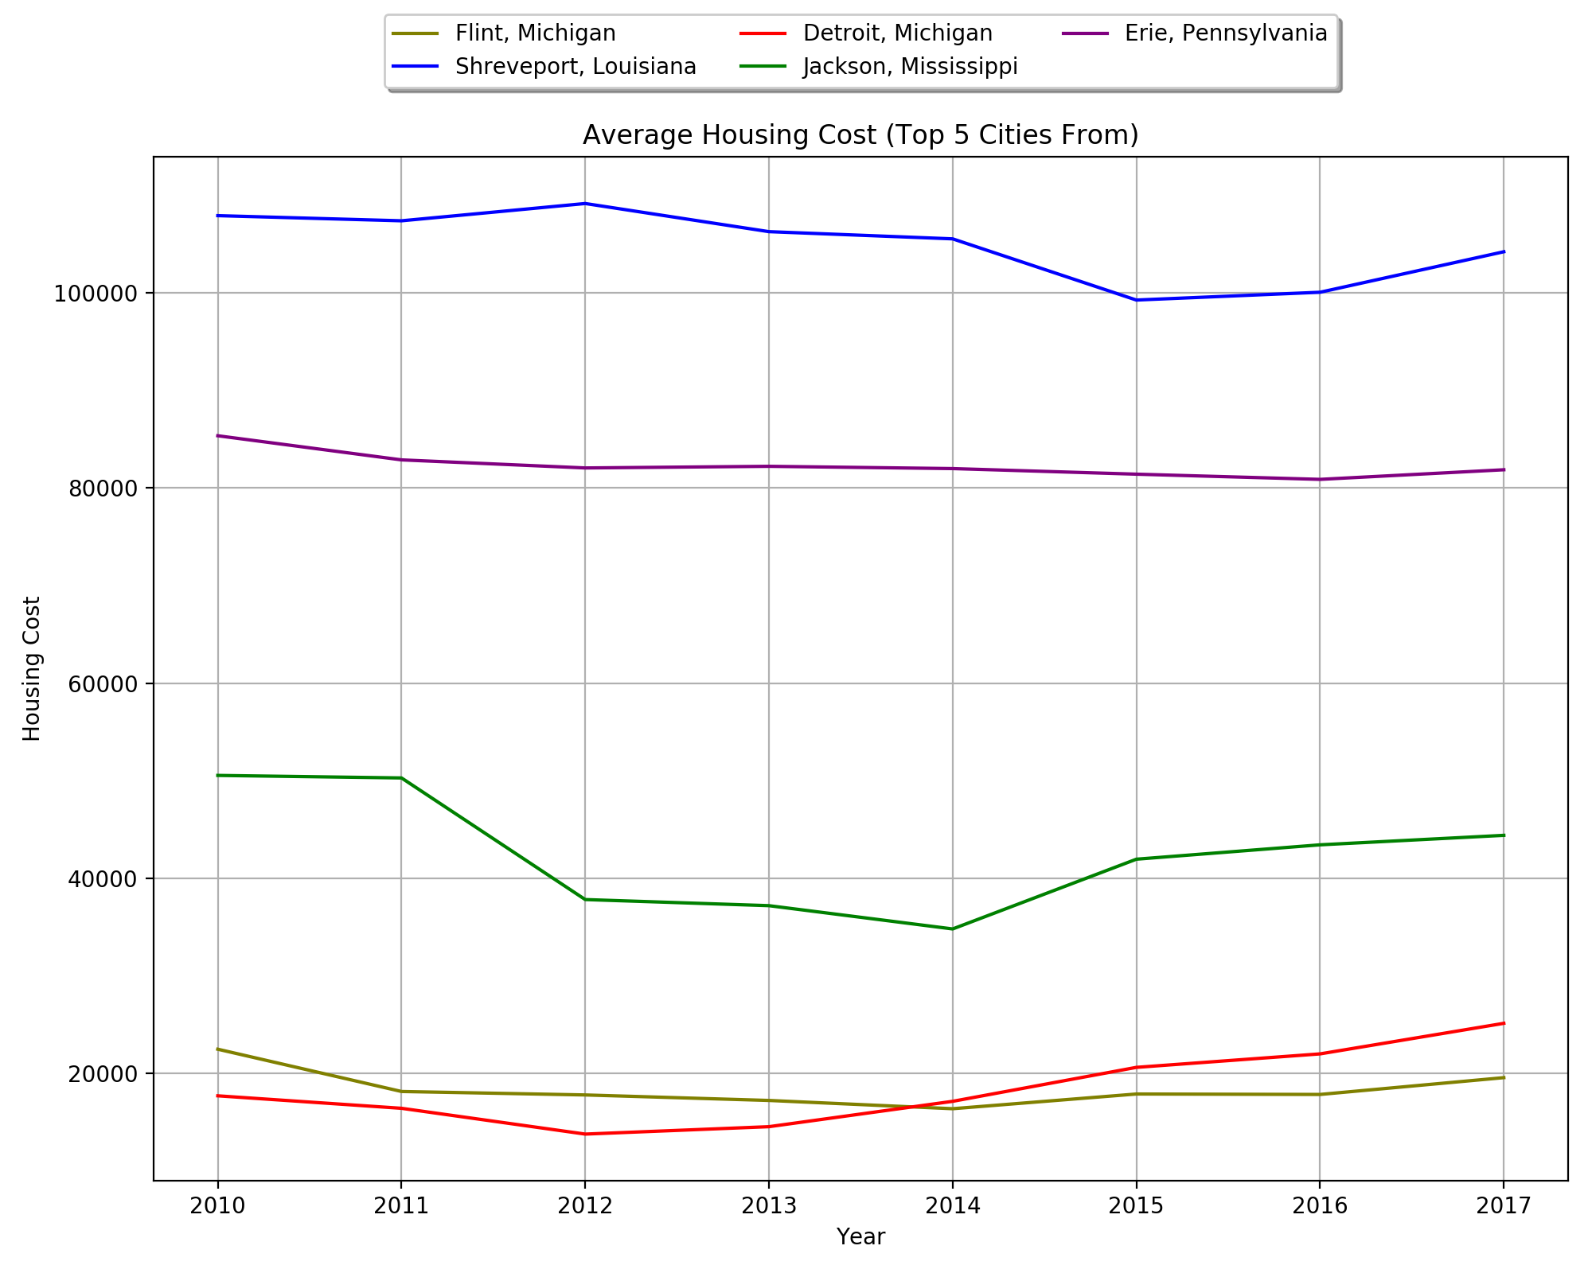
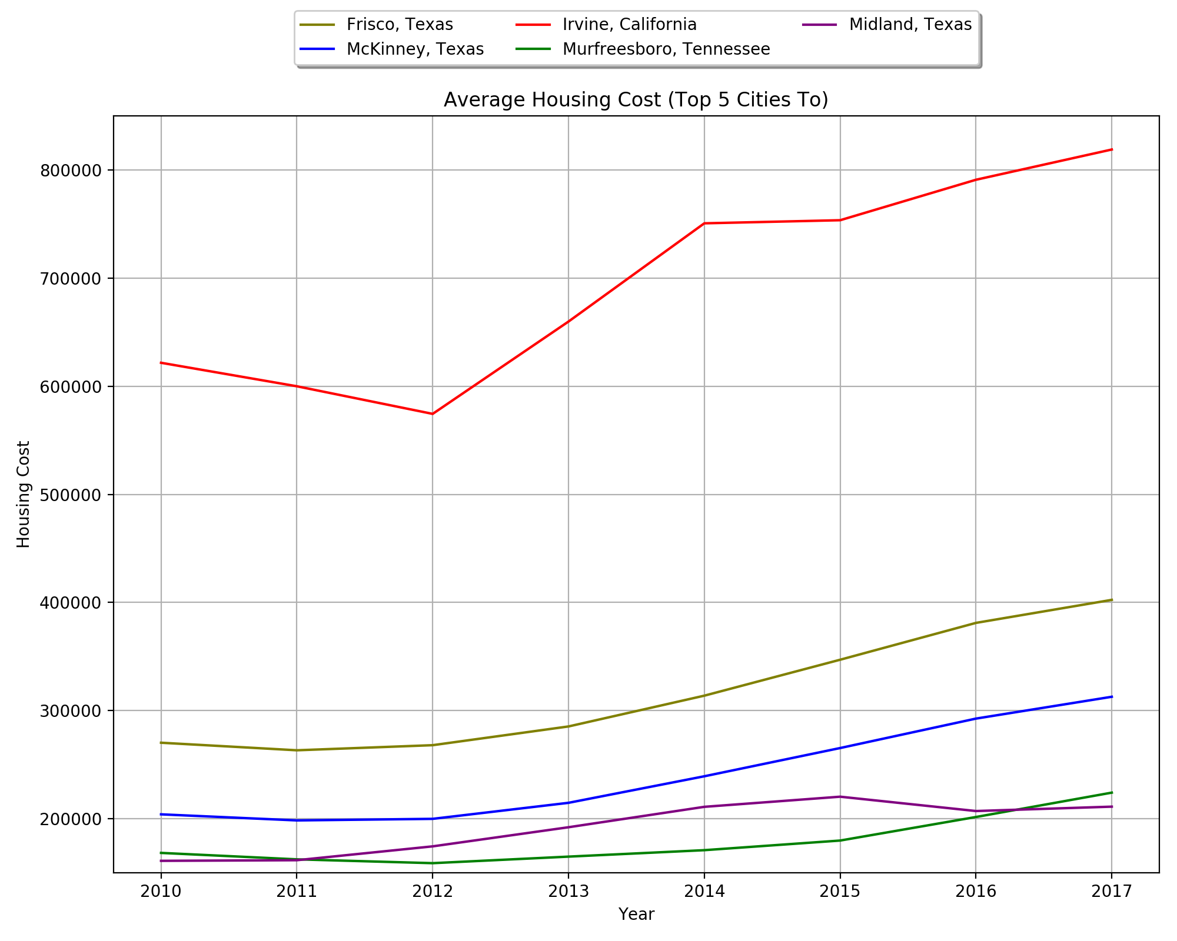
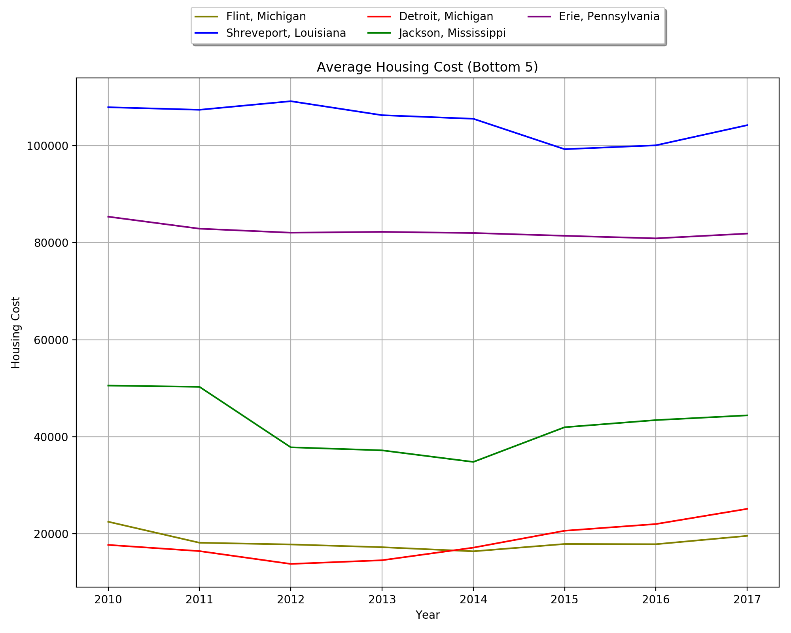
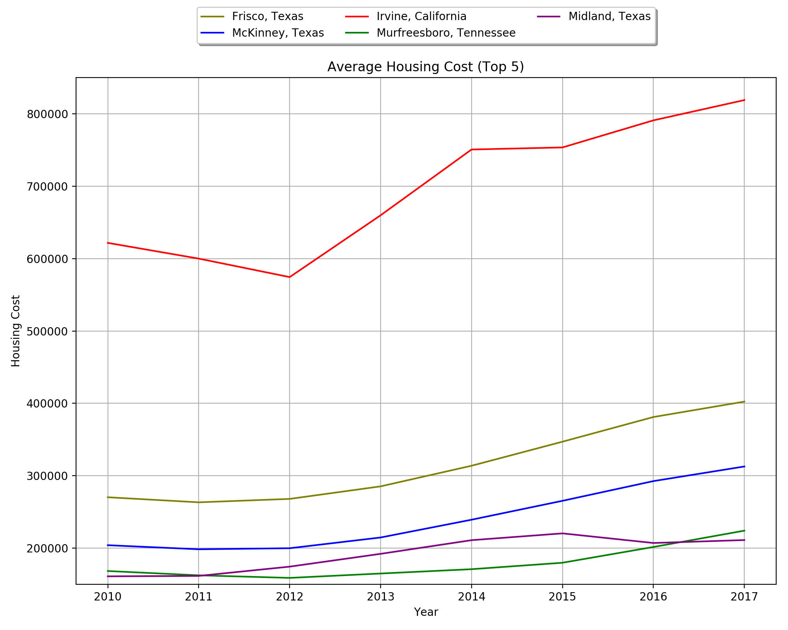
Data Analysis and Discussion Q3
Overview
Questions and Data
Data Cleanup/Exploration
Data Analysis Q1
Data Analysis Q2
Data Analysis Q3
Summary

Slide 10
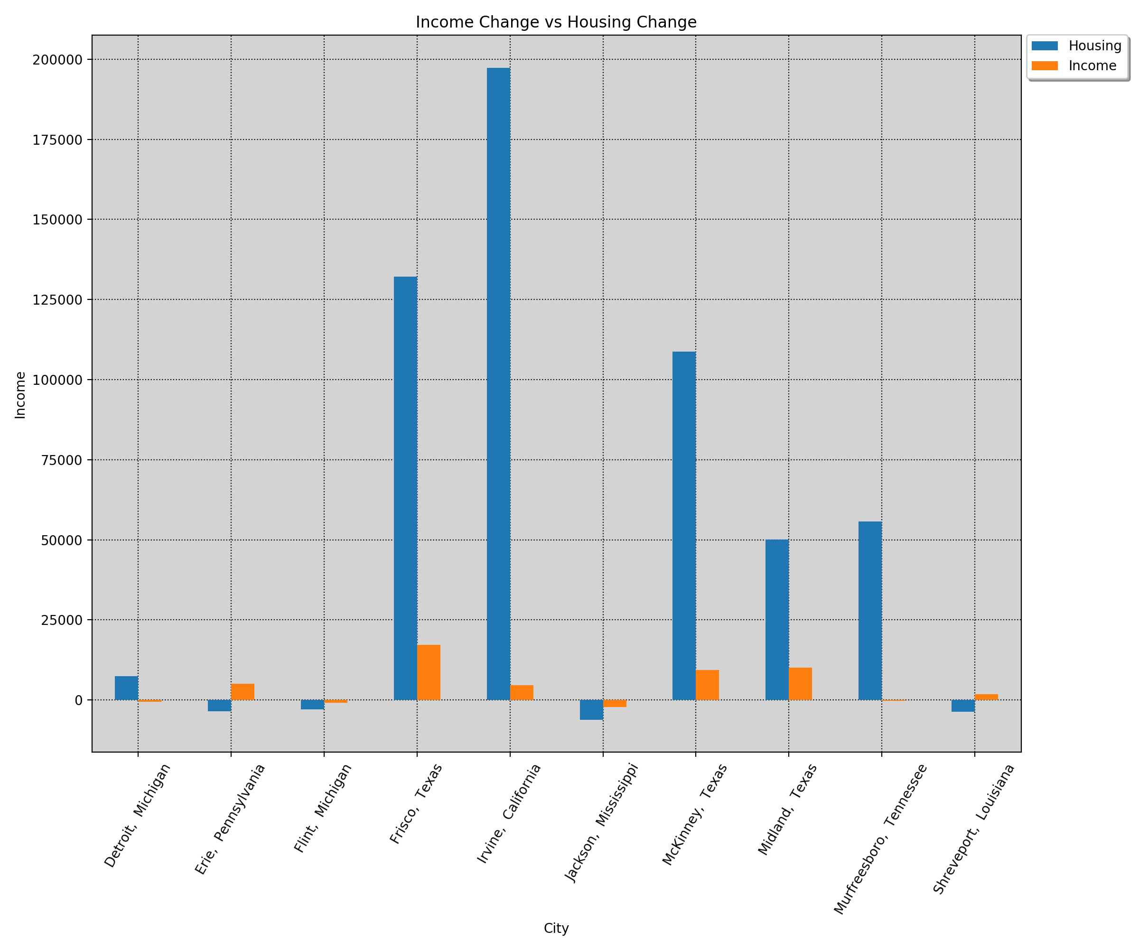
Data Analysis and Discussion Q3
Overview
Questions and Data
Data Cleanup/Exploration
Data Analysis Q1
Data Analysis Q2
Data Analysis Q3
Summary

Slide 11
Summary
Additional questions if we had more time:
What other factors contribute to people moving; weather, job opportunities, age range, etc.
From there we would then want to perform the below:
Analysis of variance
Multiple comparison of mean
Instead of analyzing the US population shifts, focus on a smaller subset.
Overview
Questions and Data
Data Cleanup/Exploration
Data Analysis Q1
Data Analysis Q2
Data Analysis Q3
Summary

